Slide 1
INTRODUCTION TO AI, AGENTS AND ENVIRONMENTS
SANTOSH GSK
SENIOR DATA SCIENTIST
INDUSTRY EXPERT
OFFCAMPUS PROGRAM

Slide 2
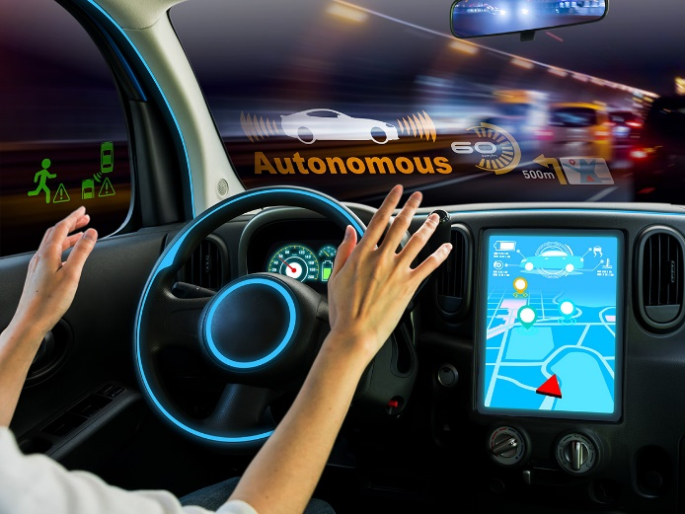
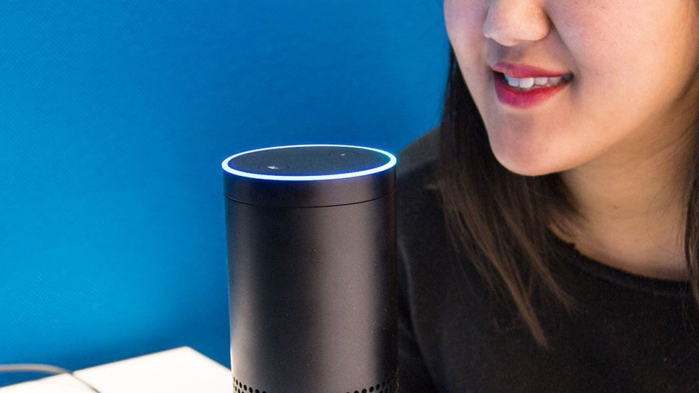
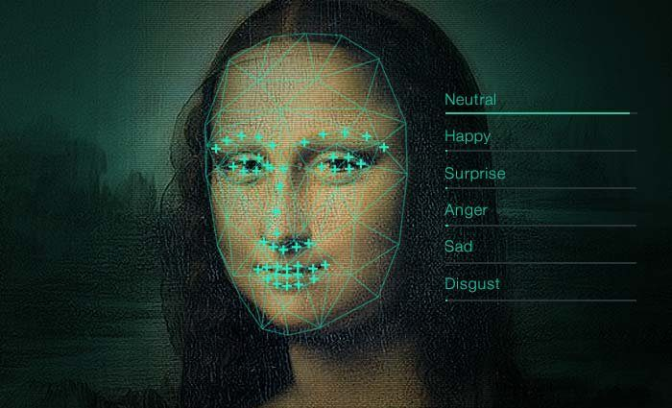
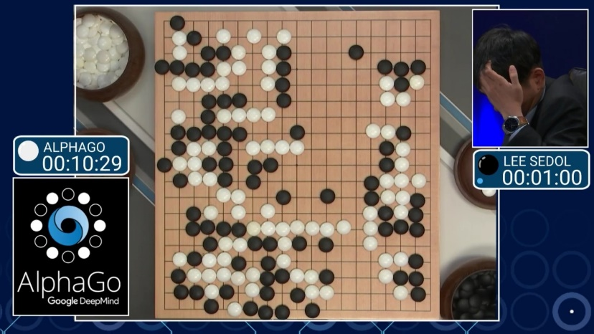
Artificial Intelligence

Slide 3

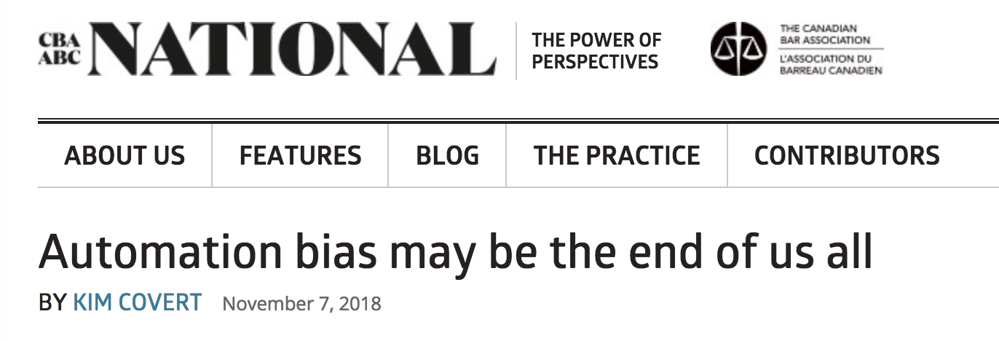
Artificial Intelligence

Slide 4
Making AI Work
Questions
Cut through the hype and see the trends
Build AI systems that can solve problems with accuracy and scale
Make AI work for everyone
Build AI that can be deployed with trust
Recognize the strengths and weaknesses
Solution: Understand the foundations of AI and then evaluate the latest trends

Slide 5
Course Objectives
Provide solid foundation for designing intelligent agents
Learn the representation and use of knowledge in inference-based problem solving approaches
Learn to apply probability theory to describe and model agents operating in uncertain environments
Learn the optimization models of computation and processing in real world application of intelligent agents

Slide 6
Learning Objectives
Understand the environment and process of development to build intelligent agents
Identify heuristics to pursue goals in exponentially large search spaces
Represent problem and derive reasoning using logical inferences
Apply probability theory to describe and model agents operating in uncertain environments
Analyse ways to supervise agents to learn and improve their behaviour

Slide 7
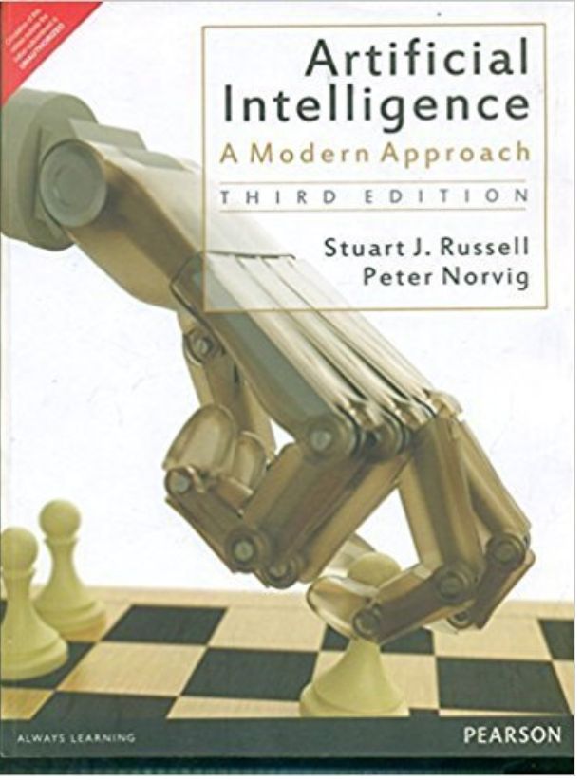

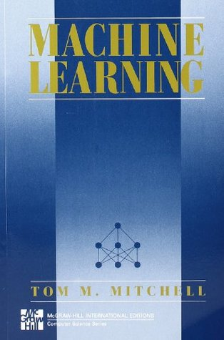
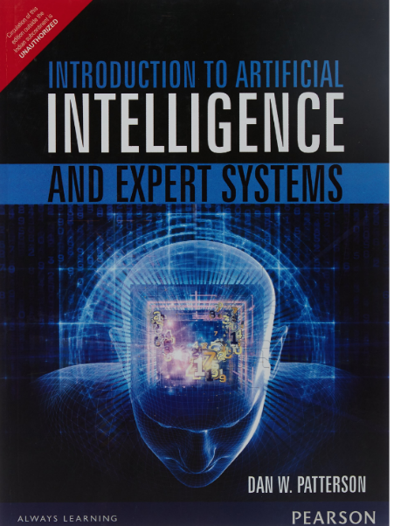
References
- The Authority of Fair in Machine Learning by Michael Skirpan, Micha Gorelick
- Interpretable Machine Learning by Christoph Molnar

Slide 8
Lecture Outline
Definition of AI
History
Introduction to Agents, Percepts, Actuators
Rational Agents
Task Environment and its variants
Agent design architectures
Reference: Chapter 1, 2 from AI: A modern approach

Slide 9
Defining AI
Universal field with solutions in many subfields
Problem Solving, e.g., playing chess
Understanding human language, e.g., Alexa
Understanding Vision, e.g., Face Recognition
Extracting patterns from data, e.g., Fraud detection and other ML algorithms
Robotics, e.g., Driving Vehicles
Hence, many possible definitions as the field has been evolving

Slide 10
Defining AI
Let’s categorize these definitions into two dimensions
Dimension 1 – Thought / Reasoning vs Acting
Thought / Reasoning – A series of brain states that can be experimentally or introspectively observed in a human brain while solving a problem.
Acting - Performing an interaction with an environment, like making a move in a chess, or taking a left turn while driving a car.
Dimension 2 – Human Performance vs Rationality
Rationality - Being right all the time
Human Performance – Not always perfect, e.g., not all chess players are grandmasters

Slide 11
Defining AI
 | Thought / Reasoning | Acting
Human Performance | THINKING HUMANLY “[The automation of] activities that we associate with human thinking, activities such as decision-making, problem solving, learning, … ” (Bellman, 1978) | ACTING HUMANLY ”The art of creating machines that perform functions that require intelligence when performed by people” (Kurzweil, 1990)
Rational Performance | THINKING RATIONALLY “The study of computations that make it possible to perceive, reason, and act” (Winston, 1992) | ACTING RATIONALLY “Computational intelligence is the study of the design of intelligent agents” (Poole et al., 1998)

Slide 12
Defining AI - Acting Humanly
It is about creating machines that can act or perform tasks which would require intelligence when performed by people.
Assume you have built a machine that can Act Humanly.
Now, let us test it
Turing Test

Slide 13
Defining AI – Acting Humanly
Interrogator
Computer
Human
Turing Test

Slide 14
Defining AI – Acting Humanly
Machine would need capabilities in
Natural Language Processing - ability to comprehend and communicate in human language
Knowledge Representation – Storing information on what it knows
Automated Reasoning - use the stored information to answer questions and to draw conclusions
Machine learning - adapt to new circumstances and to detect and extrapolate patterns
Avoided any direct physical interaction like video or touch

Slide 15
Defining AI – Acting Humanly
Total Turing Test - includes a video signal to test subject’s perceptual abilities
Additional capabilities required
Computer Vision - perceive objects and extract information
Robotics - manipulate objects and move them around

Slide 16
Defining AI – Acting Humanly
These six disciplines were the major research areas in AI
Natural Language Processing
Knowledge Representation
Automated Reasoning
Machine Learning
Computer Vision
Robotics

Slide 17
Defining AI – Thinking Humanly
Mapping of computer programs’ reasoning steps to imitate a human’s mind of solving the same problem.
Overlaps with the field of Cognitive Science
Cognitive Science
the study of thought, learning and mental organization
draws on psychology, linguistics, philosophy and computer modelling
relies on experimental investigation of actual humans or animals.

Slide 18
Defining AI – Thinking Rationally
Right Thinking – irrefutable reasoning process
Syllogisms - patterns for argument structures
always yield correct conclusions when given correct premises
E.g., Socrates is a man; all men are mortal; → Socrates is mortal
“Laws of Thought” → Govern the operation of mind
Initiated the field called “Logic”
1960s – AI algorithms were developed to solve problems using logical notation

Slide 19
Defining AI – Thinking Rationally
Two main challenges in building such systems
Not easy to represent uncertain knowledge and state in formal terms required by logical notation
It is computationally exhaustive to build systems even with a few hundred facts. Hence, such systems are not scalable.

Slide 20
Defining AI – Acting Rationally
Acting Rationally is about building Rational Agents
Agent – Something which acts, i.e., performs an action on the environment
Rational Agent - One that acts so as to achieve the best outcome or, when there is uncertainty, the best expected outcome

Slide 21
Defining AI – Acting Rationally
Rationality can include
Correct inference – using logical reasoning to perform action in order to achieve a goal, e.g., when to brake a car
Make an inference even when there is no correct inference, e.g., predicting an action in self-driving car during an accident to minimize life damage
Acting without inferring, e.g., recoiling from a hot stove is a reflex action without inference

Slide 22
Defining AI – Acting Rationally
All 6 disciplines from the Turing test also are needed to build such agents
Acting Rationally has two advantages over “Thinking Rational”
More general than the “laws of thought” – correct inference is just one of the possibilities
More open to scientific development than approaches based on human behavior or human thought (e.g., Acting Humanly)
Primary focus area of this course: General principles of building Rational Agents

Slide 23
History of AI - Gestation of AI
1943 – Warren McCulloch and Walter Pitts proposed artificial neuron
1949 – Donald Hebb invented the influential Hebbian rule to update neural connectivity
1950 – Marvin Minsky and Dean Edmonds built SNARC, first neural network computer
1950 – Alan Turing published “Computing Machinery and Intelligence” – introduced Turing test

Slide 24
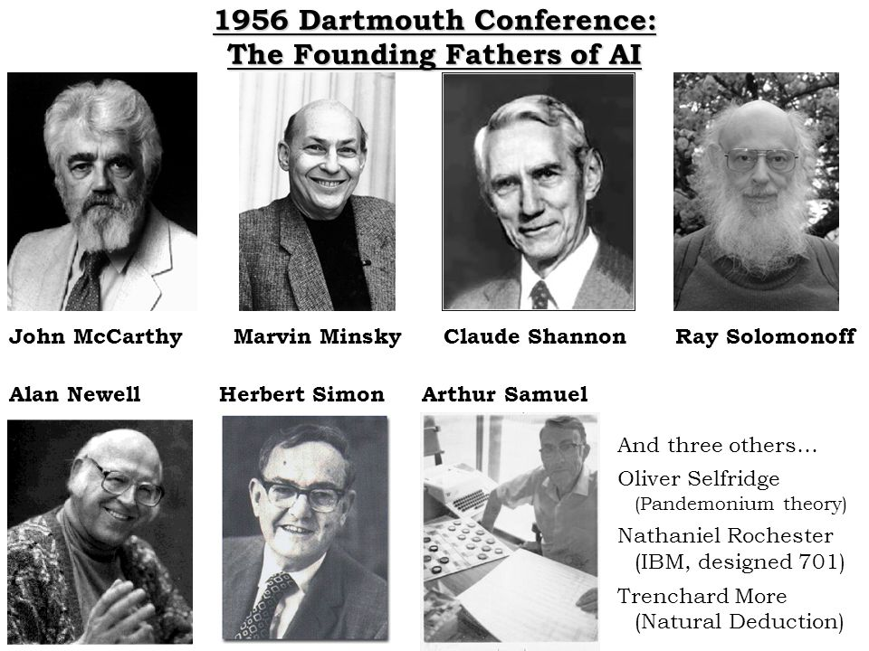
History of AI – Birth of AI
1956 - John McCarthy along with Minsky, Claude Shannon, and Nathaniel Rochester organized a two-month workshop where AI was first coined

Slide 25
History of AI - Great Expectations
1958 – John McCarthy invented Lisp programming language
1958 - John McCarthy invented Advice Taker
1959 - Newell and Simon invented General Problem Solver (GPS) - can solve problems with same reasoning steps as humans

Slide 26
History of AI – First AI Winter
1966 – Overestimation of possibilities created a hype. Failed attempt at machine translation of scientific papers from Russian to English
US National Research Council cancelled funds for academic translation project
Also, intractability of many problems in higher dimensions added to the gloom
1973 – Lighthill reported about AI’s failure to handle ”combinatorial explosion”
Major reason behind British government’s decision to end support for AI research

Slide 27
History of AI - Knowledge-based systems
1976 - MYCIN , a medical expert system to diagnose blood infections developed by Stanford performed better than many physicians
1972 – PROLOG was invented

Slide 28
History of AI – AI becoming an industry
1982 – Digital Equipment Corporation (DEC) implemented R1 expert system to configure computer orders. By 1986, it saved estimated $40 million for DEC
1988 – AI industry boomed from million to billions of dollars again with high expectations

Slide 29
History of AI – Second AI Winter
Late 1980s - LISP machines were costly when compared to general purpose machines by SUN, IBM, Apple
Early 1990s - Expert Systems were costly to maintain, unable to extend, learn

Slide 30
History of AI – Rise of Machine Learning
1990s - Machine Learning played a key role in building efficient internet tools like search engines, recommender systems, fraud, etc
”Knowledge Bottleneck” of expert systems was addressed by Machine Learning

Slide 31
History of AI – Data Deluge
2001 – Banko and Brill show that mediocre algorithms when trained on 100 million samples outperformed best algorithms when trained on 1 million samples
Data started to play crucial role, sometimes more than the algorithm

Slide 32
History of AI – Compute Power
2012 – Geoff Hinton’s group proved that GPUs can solve the computational bottleneck of using big data.

Slide 33
Intelligent Agents
Goal of AI – Build intelligent agents.
Develop a small set of design principles for building successful agents
Successful agent: Systems that can be reasonably called intelligent
Agent:
Takes input from environment through sensors → uses the input information to select an action → acts upon the environment using actuators

Slide 34
Intelligent Agent - Examples
Human Agent
Input sensors: eyes, ears
Inference: Brain
Actuators: Legs, hands, vocal tract
Robotic Agent
Input Sensors: Camera, infrared range finders
Inference: Control theory
Actuators: Motors

Slide 35
Intelligent Agent - Examples
Software Agent
Input sensors: Keystrokes, file contents and network packets
Inference: Operating System
Actuators: Display on screen, writing files and sending network packets

Slide 36
Intelligent Agents – Key Terms
Percept: Agent’s perceptual inputs, e.g., eyes, ears for humans; keystrokes for software agent
Percept Sequence: An agent’s percept sequence is the complete history of everything that has been perceived.
Agent Function: Mathematically speaking, we say that an agent’s behaviour is described by the agent function that maps any given percept sequence to an action

Slide 37
Intelligent Agent – Key Terms
Agent Program:
Agent function for an artificial agent will be implemented by an agent program.
The agent function is an abstract mathematical description;
The agent program is the concrete implementation

Slide 38
Intelligent Agent – Rational Agent
A rational agent is the one that does the right thing
What does it mean to be right?
Being rational (or being right) at any given time depends on four aspects
Performance measure that defines the success criteria
Agent’s prior knowledge of environment
Actions that the agent can perform
Agent’s percept sequence till date

Slide 39
Intelligent Agent – Rational Agent
Being rational
Selecting an action from the possible set of actions
based on the information of percept sequence and prior knowledge together
so that the selected action would optimize the performance measure.
Components of a rational agent:
P: Performance measure
E: Environment’s prior knowledge
A: Actuators, i.e., actions
S: Sensors, i.e., percept sequence
In short, it is referred to as PEAS

Slide 40
Intelligent Agent - PEAS
Agent | Performance | Environment | Sensors | Actuators
Medical diagnosis system | Healthy patient, reduced costs | Patient, hospital, staff | Keyboard entry of symptoms, findings, patient’s answers | Display of questions, tests, diagnosis, treatments, referrals
Satellite Image analysis system | Correct image categorization | Downlink from orbiting satellite | Color pixel analysis | Display of scene categorization
Interactive english tutor | Student’s score on test | Set of students, testing agency | Keyboard entry | Display of exercises, suggestions, corrections

Slide 41
Task Environment
A rational agent is built to solve a specific task.
Each such task would then have a different environment which we refer to as Task Environment.

Slide 42
Task Environment - Variants
Fully Observable vs Partially Observable
Fully Observable - If an agent’s sensors give it access to the complete state of the environment at each point in time, then we say that the task environment is fully observable.
Partially Observable - An environment might be partially observable because of noisy and inaccurate sensors or because parts of the state are simply missing from the sensor data

Slide 43
Task Environment - Variants
Single Agent vs Multi-Agent
Single Agent: For example, an agent solving a crossword puzzle by itself is clearly in a single-agent environment
Multi Agent: Whereas an agent playing chess is in a two agent environment.

Slide 44
Task Environment – Variants
Deterministic vs Stochastic
If the next state of the environment is completely determined by the current state and the action executed by the agent, then we say the environment is deterministic; otherwise, it is stochastic.
Example: Chess board is deterministic and Carrom board is stochastic

Slide 45
Task Environment – Variants
Episodic vs Sequential
Episodic: The agent’s current action doesn’t impact the state of the environment for the next action. E.g., spam classifier
Sequential: The current action could affect all future actions. E.g., any board game

Slide 46
Task Environment - Variants
Static vs Dynamic
If the environment can change while an agent is deliberating, then we say the environment is dynamic for that agent; otherwise, it is static.
Example: Video game is a dynamic environment, whereas chess is a static environment

Slide 47
Task Environment – Variants
Discrete vs Continuous
The discrete/continuous distinction applies to the state of the environment, to the way time is handled, and to the percepts and actions of the agent.
Example: Chess environment has a finite number of distinct states. Self driving is a continuous-state and continuous-time problem

Slide 48
Task Environment
Task Environment | Fully vs Partially Observable | Single vs Multi-Agent | Deterministic vs Stochastic | Episodic vs Sequential | Static vs Dynamic | Discrete vs Continuous
Medical diagnosis system | Partially | Single | Stochastic | Sequential | Dynamic | Continuous
Satellite Image Analysis System | Fully | Single | Deterministic | Episodic | Static | Continuous
Interactive English tutor | Partially | Multi | Stochastic | Sequential | Dynamic | Discrete

Slide 49
Rational Agent architectures
Building Rational agent is about designing Agent Programs that implements agent function – which is a mapping of percept to actions
Five ways of designing rational agents
Simple reflex based agents
Model based agents
Goal based agents
Utility based agents
Learning based agents

Slide 50
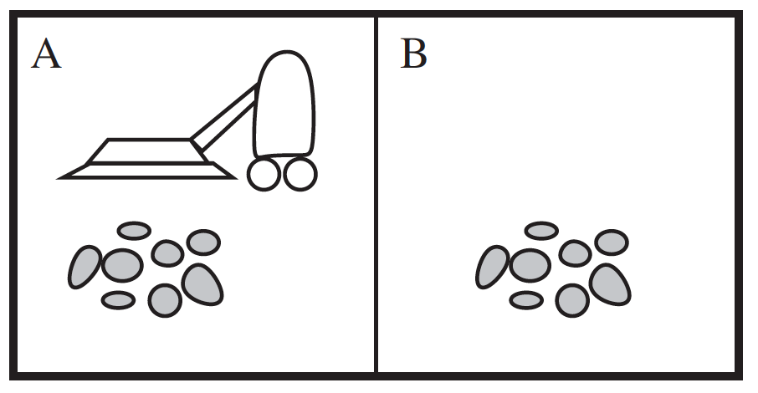
Agent Architectures – Simple Reflex
Simple Reflex Agents - These agents select actions on the basis of the current percept, ignoring the rest of the percept history.
Example:
If “car in the front is breaking” then “apply breaking”
Such rules are called condition-action rules, or simply if-else rules
E.g., Vacuum Cleaner, if not clean, then clean, else move

Slide 51
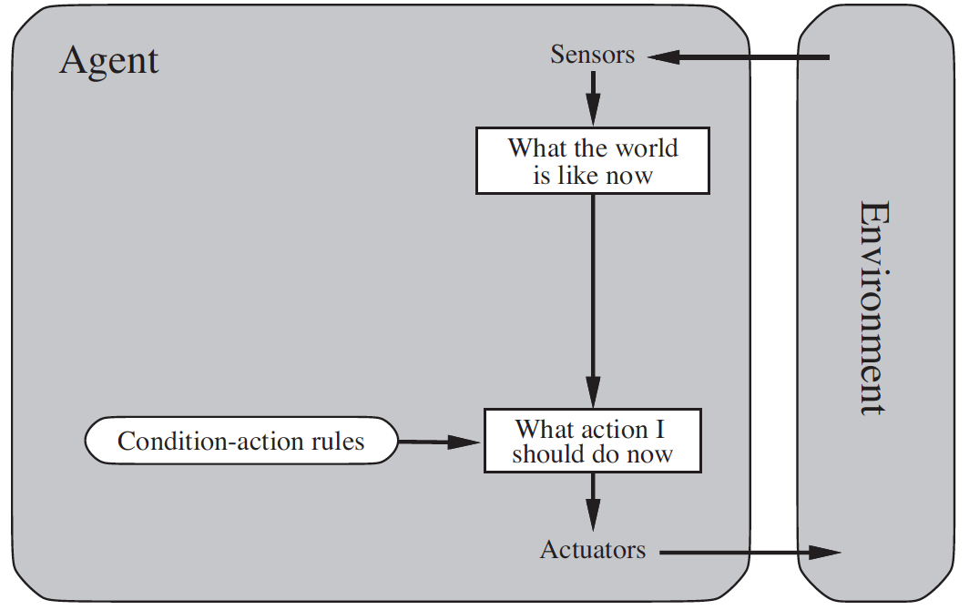
Agent Architecture – Simple Reflex

Slide 52
Agent Architecture – Model based
Limitation of Simple Reflex
Partial observability of the current state as it doesn’t store any state information
E.g., Vacuum Cleaner
Keep an internal state of the environment to solve for the partial observability environments

Slide 53
Agent Architecture – Model based
Model based agent: This knowledge about “how the world works”—whether implemented in simple Boolean circuits or in complete scientific theories—is called a model of the world.

Slide 54
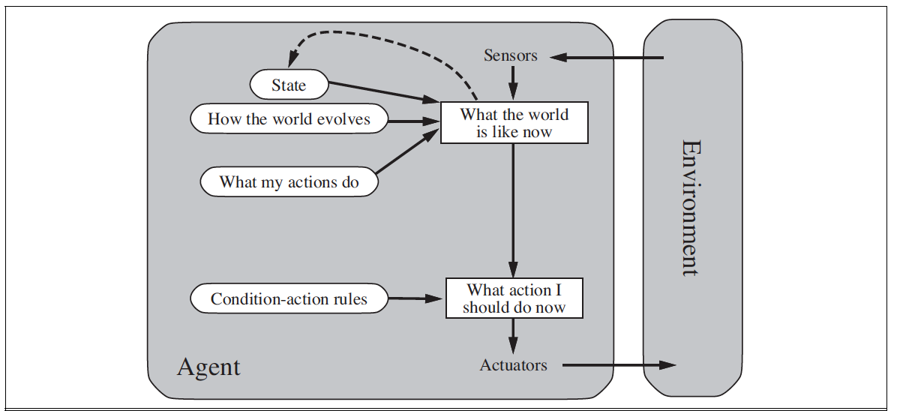
Agent Architecture – Model-based
Model based agent architecture

Slide 55
Agent Architecture – Goal based
Limitation of Model based
Knowing the current state of environments is not always enough to decide next move
E.g., self driving car at a junction can take three directions, the decision to pick one should depend on the end destination, i.e., goal
Goal-based agent: Combining goal information with the model information to select actions

Slide 56
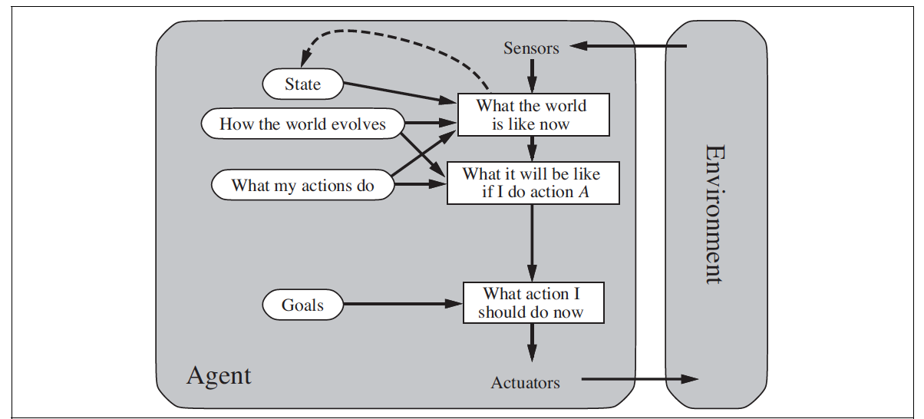
Agent architecture – Goal based
Goal based Agent Architecture

Slide 57
Agent Architecture – Utility based
Limitation of Goal based agent
Goal info alone cannot disambiguate actions
Example: Reaching a destination sometimes would have multiple routes with different distances, time.
Solution: Have a performance measure that would assign a score to multiple solutions that can reach a goal.
Utility function: Internal implementation of performance measure that helps the agent to select actions
Utility-based agents: Any agent that optimizes its actions based on such utility functions are utility based agents.

Slide 58
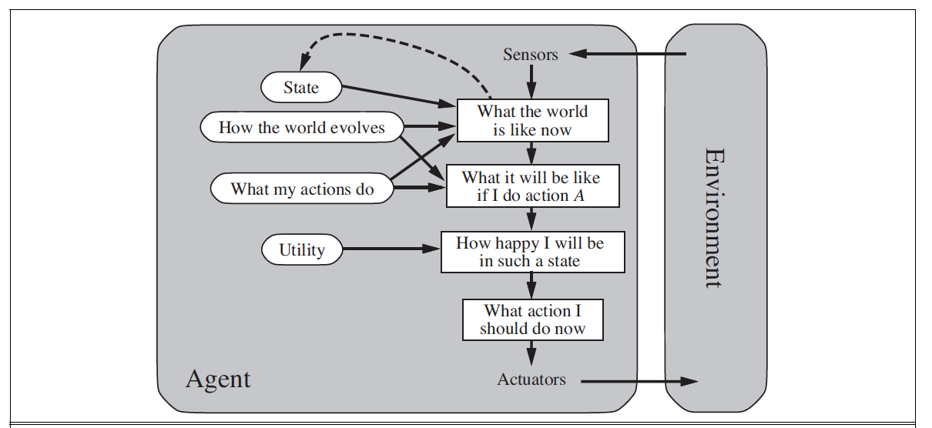
Agent Architecture – Utility based
Utility based Agent Architecture

Slide 59
Agent Architecture – Learning based
Agent Program (mapping of current and historical percepts to actions) are predetermined in earlier agent architectures
Learning agent – learns the agent program based on data
Advantages above other methods
Initially operate in unknown environments and become more competent than its initial knowledge alone might allow.
Preferred model to build state-of-the-art systems.

Slide 60
Agent Architecture – Learning based
It has four conceptual components
Learning element – modifies the agent program
Performance element – responsible for selecting external actions
Critic – It evaluates the actions and gives it as feedback to Learning element
Problem generator – Performs exploration on different actions possible in order to gain information to discover much better actions in the long run.
E.g., learning about the steering of vehicle at corners.

Slide 61
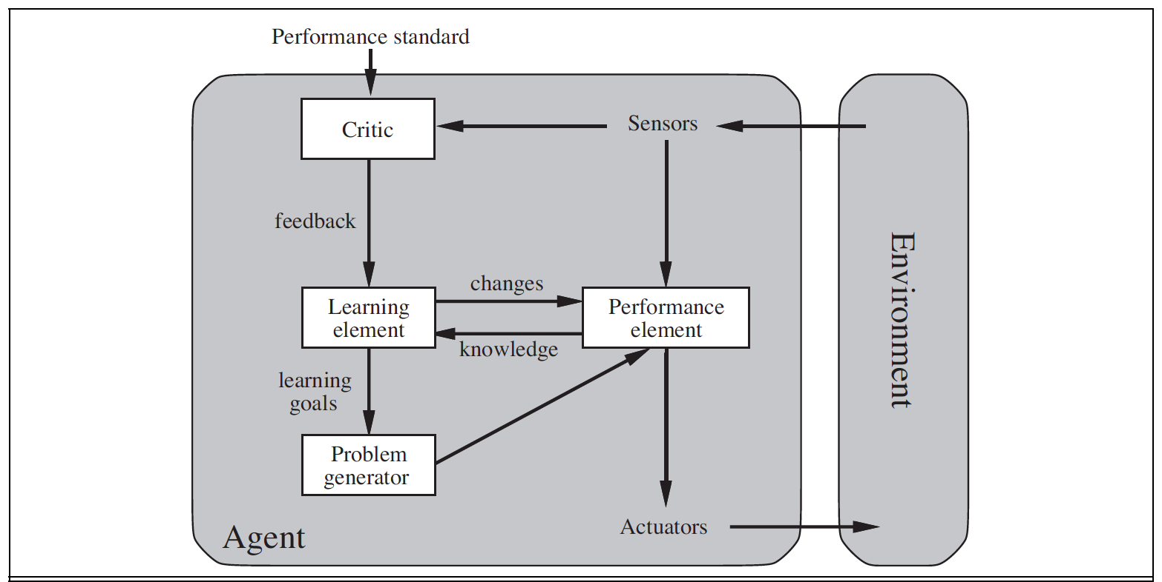
Agent architecture – Learning based
Learning based Agent Architecture

Slide 62
Thank You!
In our next session:

